Slide 1
RITUAL TRADITION
MEANS OF EXPRESSION
UNDERLYING DOCTRINAL PRINCIPLES
GATHIC ERA
NO RITUAL PRACTICES
YOUNGER AVESTAN COMMUNITY
YASNA HAPTANHAITI
PAHLAVI ERA
PAZEND-AVESTAN COMPOSITIONS
ADURBAD –E- MAHRASPAND

Slide 2
RITUAL CLASSES
PARTICIPATORY
OR
OUTER LITURGIES
SOCIO-RILIGIOUS CEREMONIES
NON-PARTICIPATORY
OR
INNER ( HIGHER) LITURGIES
CONSECRATIONAL

Slide 3
RITUAL OF JASHAN
FESTIVITY OF NATURE
PRIVATE FAMILY CELEBRATION
PRIVATE OR PUBLIC MEMORIAL
COMMUNAL CELEBRATIONS
HOUSE WARMING
CELEBRATE A NEW BUSINESS VENTURE
AFIRNGANS AND AFRINS
BLESSINGS
APPROPRIATELY MODIFIED FOR THE OCCASION

Slide 4
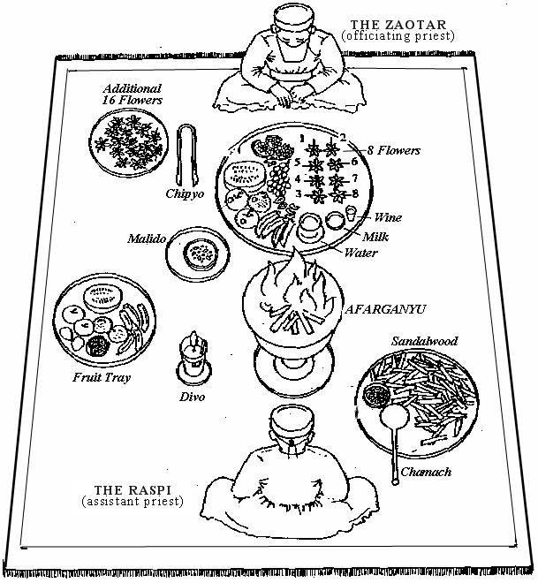

Slide 5
ZAOTAR - PRINCIPLE INVOKER
SYMBOLIC - SPIRITUAL DOMAIN
RASPI – JUNIOR / ATRAVAKSH
SYMBOLIC – CORPOREAL DOMAIN
LIURGY OF FIRE
FIRE- THE SON OF AHURA MAZDA QUINTESSENCE OF THE CREATOR
GATHIC SCRIPTURES INCORPORATED
IN THE LITURGY
CIRCUIT OF COMPLESION - TWO DOMAINS - SPIRITUAL & PHYSICAL

Slide 7
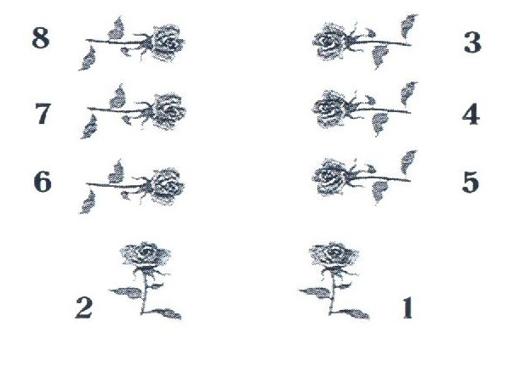

Slide 11
RITUAL PURITY
PURIFICATORY RITUALS
PURITY OF MIND, BODY AND SOUL
REFLECTS THE DIVINE WITHIN
PADYAB RITUAL
AV. PAITI-AP –SPRINKLING WATER
RINSING EXPOSED PARTS OF THE BODY
PERFORMED BEFORE
INITIATING ANY RITUAL

Slide 12
NAHN RITUAL
RITUAL OF SACRED BATH
ADMINISTERED TO LAITY
BEFORE WEDDING & CONFIRMATION
SACRED MANTRA
CHEWING OF POMEGRANATE LEAVES
SYMBOLIC SIPPING OF NIRANG
FOLLOWED BY RINSING
THE BODY WITH WATER
PURIFICATION OF MIND AND BODY

Slide 13
BARASHNUM-E-NO SWA
THE MOST ELABORATE RITUAL
AV. BEREZ –TOP OR HEAD
WASHING FROM HEAD TO TOE
SECLUSION OF NINE NIGHTS
INDIVIDUALS TO BE ORDAINED
AS PRIEST
COMPLEX RITUAL OF TWO STAGES
NAAVAR AND MURTAB
INVOLVING ABOUT SIX WEEKS

Slide 14
CONFIRMATION-NAVZOTE
ZOROASTRIAN CHILD
INDUCTED INTO THE FAITH
NAVZOTE – NEW DEVOTEE
AGE 7-11 AS LATE AS AGE 15
SACRED SHIRT – SUDREH
PATH OF PURITY
GIRDLE AROUND THE WAIST-KOSHTI
WOVEN – 72 WOOLEN THREAD

Slide 15
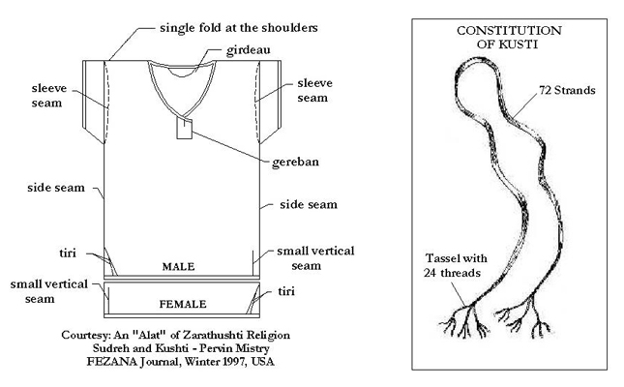

Slide 16
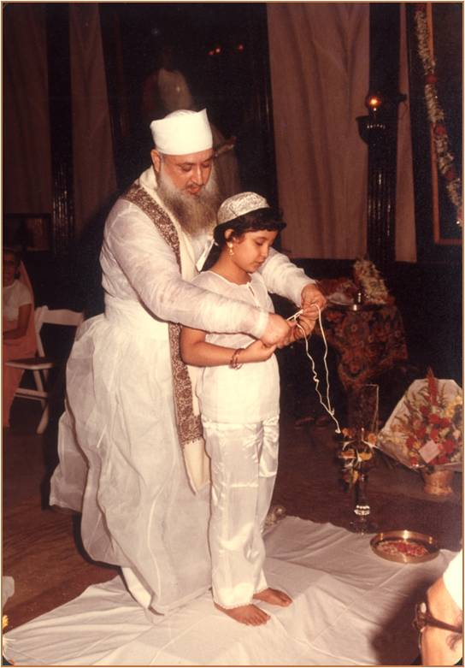

Slide 17
INNER LITURGIES
CONSECRATION RITUALS
PLACE OF WORSHIP, IMPLEMENTS
FESTIVE AND MEMORIAL
YAZESHNE, VANDIDAD, VISPARAD,
BAJ RITUALS
PRIEST-FULLY ORDAINED AND UNDERGONE BARESHNUM
PAV-MAHAL- PURE CONSECRATED PLACE FOR THE RITUALS

Slide 18
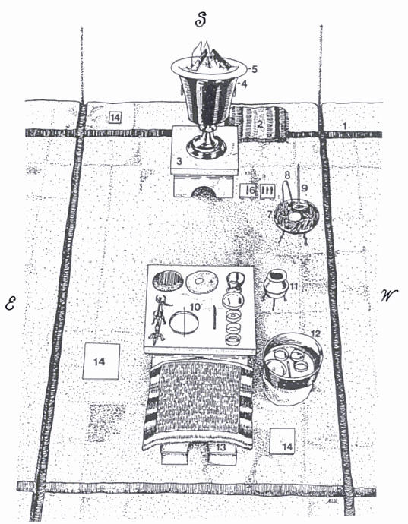

Slide 19
COMPLEX CADRE OF PRIESTHOOD
PRIESTHOOD PROLIFERATION IN
SASANIAN ERA
VISPERAD, NIRANGISTAN
SEVEN PRIESTS PERFORMED CERTAIN INNER LITURGIES
ZAOTAR AND SIX OTHERS
TODAY THESE RITUALS
PERFORMED BY TWO CLERGIES
ZAOTAR AND RASPI

Slide 20
CONCLUSION
FUNDAMENTAL RITUAL EXPRESSION OF CONCEPTS PRESERVED
MODALITY SIGNIFICANTLY ALTERED
WHAT DOES NOT CHANGE WITH TIME TENDS TO STAGNATE
CORE GATHIC TEACHINGS IMMUNED
FOR
THEY ARE THE LAWS OF TRUTH
RITUALS ARE MEANS TO AN END

